Slide 1
Sales POC using Copilot SDK and Foundry IQ
Sales POC App Url: https://salespoc.azurewebsites.net
Problem
Sales teams need fast answers across fragmented data (customers, products, orders, reps, regions).
Traditional BI/report workflows are too slow for in-meeting decisions.
Non-technical users struggle to query operational data without analyst support.
Solution
Sales POC provides one unified experience (Angular/Ionic web + mobile) for operational views and analytics.
API-first integration through Azure API Management exposes governed Sales APIs and MCP endpoints.
AI Foundry Sales Agent + chat assistant enables natural-language access to sales insights and documents.
Measurable Impact
Time-to-insight: Less than 30 seconds for common sales questions using AI Chat Assistant.
Self-service analytics adoption: 95% of seller queries answered without analyst escalation.
Sales operations turnaround: 800 hours (20 FTEs) saved/week** via unified data + conversational workflows.
Platform efficiency: backend idle/caching strategy reduces always-on compute cost while preserving UX.
Prepared by:
Michael Yaacoub
Sr. Solution Engineer – AI Applications
Microsoft
Notes:
Talk Track (30-45 sec)
SalesPOC reduces friction between operational data and decisions. Instead of hopping between systems, sellers get customer, product, order, and trend insights in one app, with AI-assisted query support. The architecture is enterprise-ready with governance, security, and reusable API contracts.

Slide 2
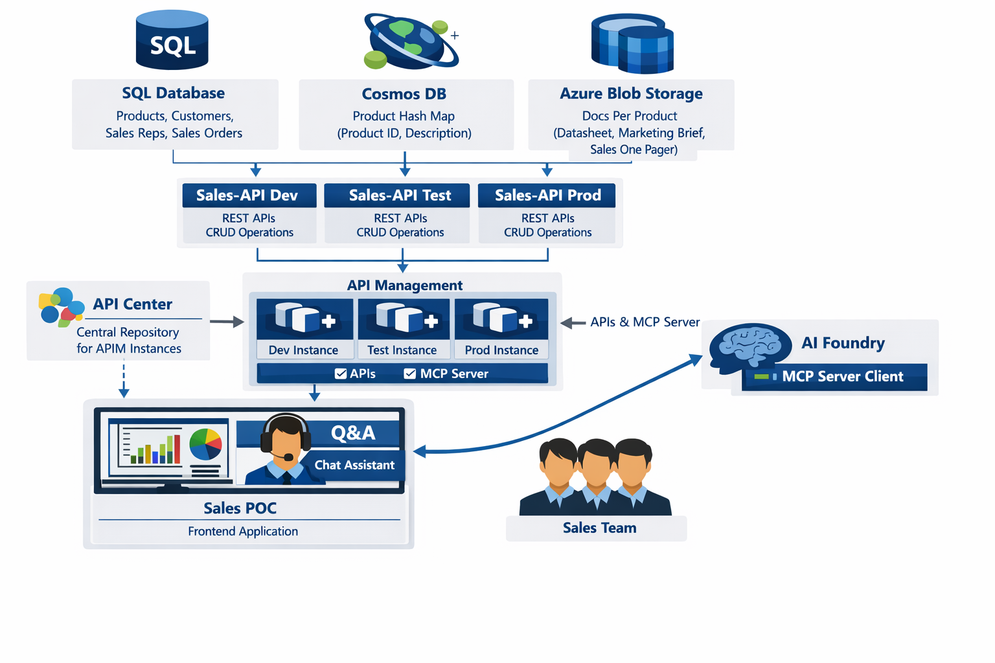
Architecture Diagram
1
1. Data Layer
Azure SQL: customers, products, sales reps, orders, line items
Cosmos DB: product descriptions
Blob Storage: product docs
(datasheet, market brief, sales one-pager)
2. API + Governance Layer
Sales API hosted on Azure Container Apps.
Azure API Management as gateway for REST + MCP exposure.
Azure API Center for discoverability and lifecycle governance
3. AI + App Experience Layer
Azure AI Foundry hosts Sales-Agent using Sales API MCP tools.
Sales POC UI consumes Sales API via APIM and exposes chat assistant to end users.
4. Operational Excellence
Session caching + retry/circuit-breaker behavior improves resilience during backend cold-start.
CI/CD-ready structure and environment-based configuration support enterprise rollout.
2
3
4
Repo URL(s)
https://github.com/csdmichael/SalesPOC.UI - UI
Related repos:
- https://github.com/csdmichael/SalesPOC.API – REST API - App Service
- https://github.com/csdmichael/SalesPOC.Containerized.API - ACA
- https://github.com/csdmichael/SalesPOC.DB – SQL, Cosmos, Blob
- https://github.com/csdmichael/SalesPOC.AI – Foundry Agent
- https://github.com/csdmichael/SalesPOC.MCP – MCP Servers
- https://github.com/csdmichael/SalesPOC.APIM – API Management
- https://github.com/csdmichael/SalesPOC.APIC – API Center
Notes:
Talk Track (45-60 sec)
This architecture separates concerns cleanly: data stores for transactional and unstructured content, a governed API layer for secure access, and an AI-enabled user experience for natural-language insights. The pattern is reusable across business units and supports both operational reporting and conversational analytics.

